Slide 1
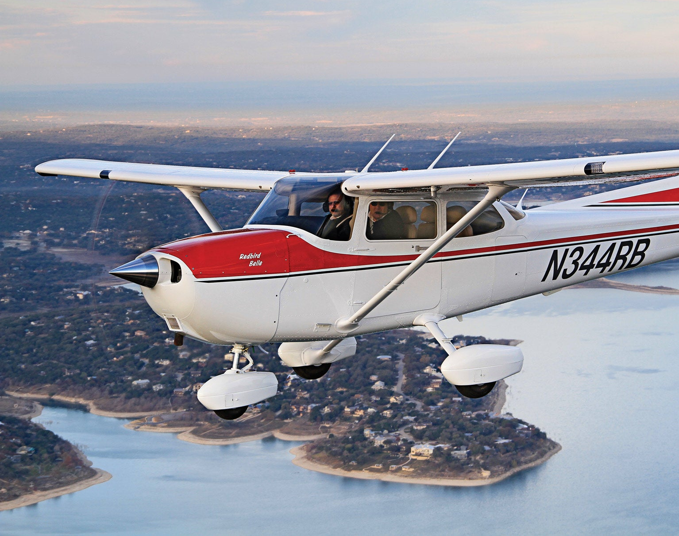
Aircraft Maintenance Prediction
Section G2 Group 10
Kimberly Bertoli
Do Thi Phuong Linh
Nguyen Kim Hau Tanya Arora
Cheung See Lin

Slide 2


Business Problem
Problem Statement:
A good maintenance plan is one of the key drivers to ensuring an aircraft is fit for function.
Maintenance can be largely categorized into two:
Planned maintenance
Unplanned maintenance
Predictive maintenance can allow for accurate lifetime prediction of components therefore pre-emptively replacing components that will be damaged in between maintenance cycles potentially shifting the maintenance time spent in the unplanned region, over to the planned region.
 | Without ML | With ML
Core Idea | Scheduled inspections and manual fault checks | Predict maintenance risks using historical flight telemetry
Pattern Detection | Limited to fixed rules and thresholds | Learns complex multivariate time-series patterns
Data Used | Manual inspections and safety checks | Per-second aircraft sensor and maintenance data
Adaptability | Rules updated manually | Adapts to changing flight behaviour automatically
Accuracy | May miss early warning signs | Improves anomaly and maintenance prediction
Scalability | Difficult across large fleets | Scales across thousands of flights
Output | Reactive maintenance actions | Predictive maintenance alerts and early warnings
Predictive maintenance model enables the airline to proactively address fleet maintenance needs, reduced inventory cost, prevent potential flight delays and optimise engineering productivity

Slide 3
Methodology
EDA and Data cleaning
Exploration of dataset
Model Building and Selection
Exploration of different models with minimal tuning to review effectiveness
Tuning and Refinement
Hyperparameter tuning using Optuna
Data cleaning and aggregation
Selection of final model
Ensemble / Stacking models
Evaluation of Model and Conclusion
Evaluation of Recall, AUC, F1 Score, etc.
Conclusion and discussions
Feature Engineering and Pre-processing
Missing value analysis
Class imbalance check
Correlation matrix to identify redundant features
Feature engineering such as rolling stats (mean, std, max), interaction features
Training, validation, test, unseen data split
Feature selection and normalization (MinMax or StandardScalar)
Repeat if necessary
Train / 70%
Validation / 15%
Test / 15%
Goal is to predict maintenance required based on a fixed set of labels, the ML approach will be that of a classification problem. By analyzing flight sensor patterns before and after maintenance events, the model will predict maintenance-related risk states, helping airlines enable earlier inspections and proactive maintenance planning.

Slide 4
Dataset and Proposed ML Solution
This dataset uses flight records and unplanned maintenance logs from a Cessna 172 aircraft, sourced from the National General Aviation Flight Information Database (NGAFID)
29k
flights
4,400
Median timesteps per flight
Multivariate time series of sensor/flight ⇒ 113 million records
36
Unique maintenance label type
23
Sensor data
+ 7 Metadata columns
X
=
Sensor Data
Flight Metadata
Column Name | Description
volt1 | Main electrical system bus voltage (alternators and main battery)
volt2 | Essential bus (standby battery) bus voltage
amp1 | Ammeter on the main battery (+ charging, - discharging)
amp2 | Ammeter on the standby battery (+ charging, - discharging)
FQyL | Fuel quantity left
FQyR | Fuel quantity right
E1FFlow | Engine fuel flow rate
E1 OiIT | Engine oil temperature
E1 OiIP | Engine oil pressure
E1 RPM | Engine rotations per minute
E1 CHT1 | 1st cylinder head temperature
E1 CHT2 | 2nd cylinder head temperature
E1 CHT3 | 3rd cylinder head temperature
E1 CHT4 | 4th cylinder head temperature
E1 EGT1 | 1st Exhaust gas temperature
E1 EGT2 | 2nd Exhaust gas temperature
E1 EGT3 | 3rd Exhaust gas temperature
E1 EGT4 | 4th Exhaust gas temperature
OAT | Outside air temperature
IAS | Indicated air speed
VSpd | Vertical speed
NormAc | Normal acceleration
AltMSL | Altitude miles above sea level
Column Name | Description
Master Index | Primary Key to link to the flight records
Before After | Whether or not a flight occurred before or after maintenance. Some flights occurred during maintenance (generally test flights)
Date Diff | Days before or after the maintenance period
Flight Length | Number of flight recordings for the whole flight (duration of flight in seconds)
Label | Maintenance Issue
Hierarchy | Maintenance Issue Hierarchy, if NaN then Other.
Number of Flights Before | The Nth flight before maintenance, with 0 representing the flight immediately before and -1 representing not applicable.
Input Features (X)
23-channel multivariate time series (engine, fuel, electrical, flight performance)
Binary
Classification Problem
Target Output (Y)
Target: P(RUL > t days), binary, from before_after + date_diff
RUL = Remaining Useful Life
Dataset: https://www.kaggle.com/datasets/hooong/aviation-maintenance-dataset-from-the-ngafid

Slide 5
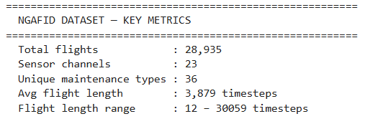
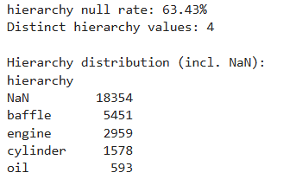
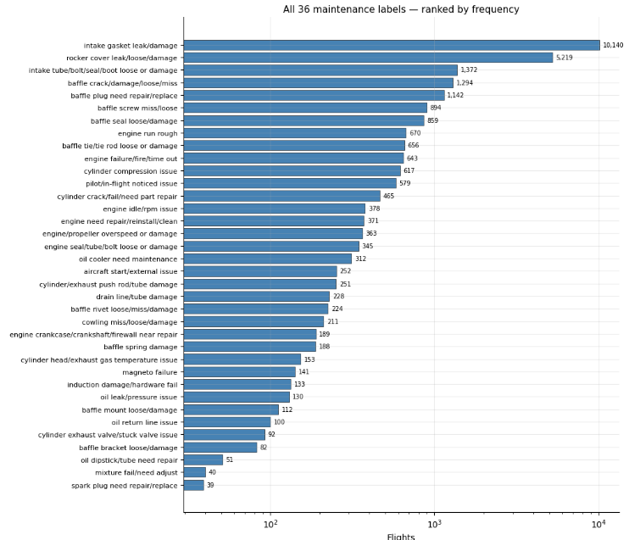
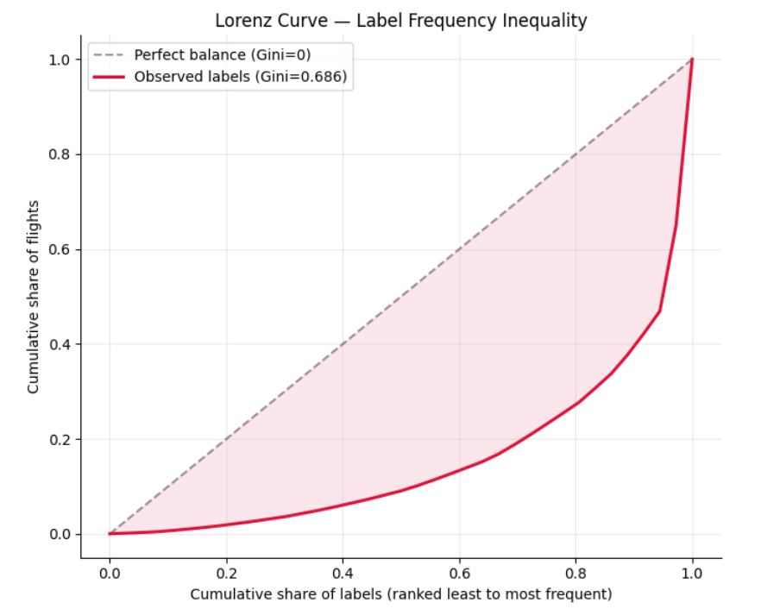
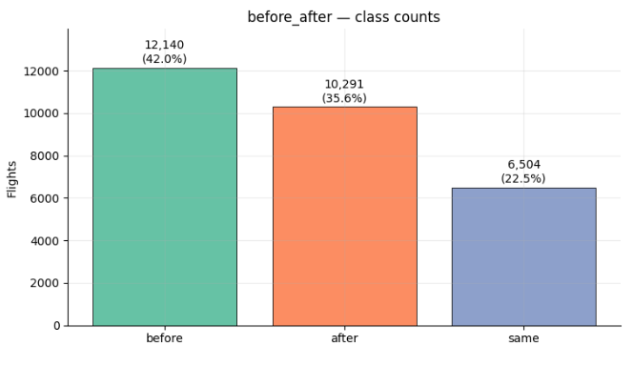
EDA Summary
Dataset spans 28,935 flights across 36 distinct maintenance event types, concentrated 35% on intake gasket leaks alone, showing maintenance burden is unevenly distributed
Before/ After/ Same label distribution is 42% / 36% / 22% → mild imbalance (class ratio 1.87x)
Severe long tail in 36-class label (Gini 0.686) → > 0.6 is severe, > 0.7 is extreme long-tail
63.4% of rows have no hierarchy value. Hierarchical multi-task learning is not feasible with this label
Correlation analysis suggests sensor redundancy: 23 channels → 11 after deduplication

Slide 6
ML Models and Performance Evaluation
Evaluation Criteria
MODELS FOR CONSIDERATION
XGBoost (Tabular aggregate features)
MiniRocket (Time Series)
Inception Time (1D-CNN) (Time Series)
Time Series Transformer
Recall (Sensitivity)
Precision
A false negative clears an at-risk aircraft to fly again, so the failure risk falls on the next sortie. High recall minimizes this safety-critical miss.
Avoids too many unnecessary maintenance calls (false positives), which are costly and reduce fleet availability.
Ensemble
F1-Score
ROC-AUC / PR-AUC
Harmonic mean of Precision and Recall. Penalizes models that sacrifice one for the other, balancing safety against operational disruption.
Threshold-independent measures for comparing all models fairly. PR-AUC supplements ROC-AUC when class distribution is imbalanced.
Stacking
Confusion Matrix
Inference Time
Full breakdown of TP, TN, FP, FN mapping directly to operational outcomes: correctly flagged, correctly cleared, unnecessary inspections, and missed faults.
Time to score a single completed flight at deployment. Must be fast enough to inform the pre-flight check before the aircraft's next sortie.

Slide 7
Analysis and Model Building (Potential Limitations)
Potential Limitations | Description | Addressed By
Limited to Only Cessna 172 plane type | The dataset contains sensor and flight data of only Cessna 172 plane type | As this study is meant as a proof of concept and preliminary study for predictive maintenance in the aviation industry, it is not meant to be comprehensive. In order to extend to other plane types, a different ML model will need to be built for every plane since they will have different sensors characteristics.
The dataset is only for US | The dataset is only for US Cessna 172 planes. There may be deviations in environmental factors e.g. temperature, humidity etc., which may be outside the range of the training dataset | The models built for this study will require field validation for every new environment it will operate in. This will in turn provide insights on whether the features and dataset are sufficient to successfully implement a predictive maintenance plan or if extra sensor will be required.
Information is loss due to grouping | Due to grouping, the breakdown of the required maintenance is lost. | The purpose of the study is not to do away with pre-flight inspections, but to allow for better maintenance planning via targeting of the selected group.
Class Imbalance in Label | 2 out of 36 labels contain fewer than 50 samples. Some classes having thousands of flights and others having less than one hundred. | Rare labels will be grouped into broader categories, improving sample representation per class and focal loss to be applied during training to place greater emphasis on under-represented classes and reduce bias toward majority classes.

Slide 8

Application and Future Scope
The study will be conducted to evaluate the feasibility of predictive maintenance for aircraft targeting audience such as airline operators, aviation safety regulators and OEMs.
The study, while limited in scope due to data from a singular plane type, allows for a controlled scale study from which to carry our further validation studies.
The next step is to observe over a period of time whether a new maintenance strategy based on the model will be able to successfully reduce unplanned downtime risk and save cost for the operator.
As this study is conducted only for a small population of private jets, the strategy can be modified such that a “just-in-time” model can be established. This will serve as a proof of concept, beyond which the same study can be extended to commercial plane types such as Airbus A320, Boeing 737 Max etc.

